Slide 1
Specifying Children

Slide 2
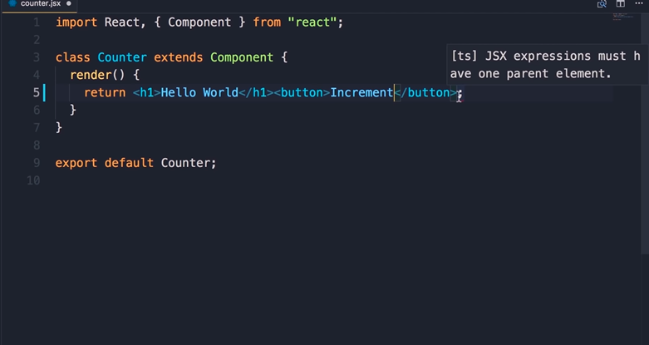

Slide 3
add a button right after h1 set the inner text to increment now it can immediately see a compilation error here
you have a red underline JSX expressions must have one parent element
why is that as we discussed ealier JSX expressions get compiled to a call to
React.createElement now the first argument to this method is the type of the element that we want to create in this case h1 but when we have two elements side by side Babel doesn't know how to compile this long expression into a call to react.createElement what is the type of the react element that should be returned from the render method we can tell

Slide 4
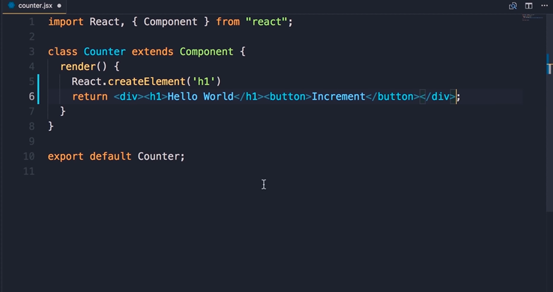

Slide 5
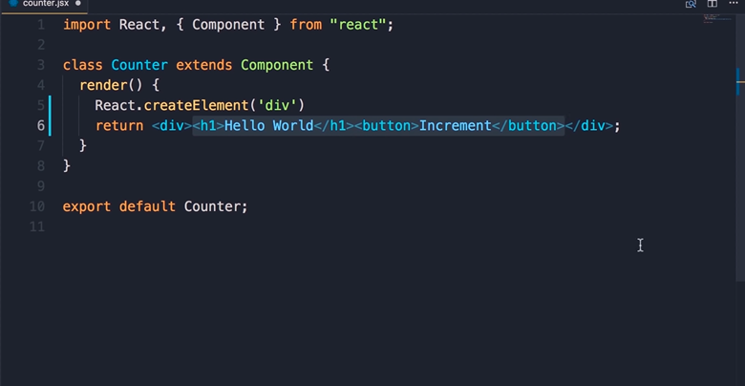

Slide 6
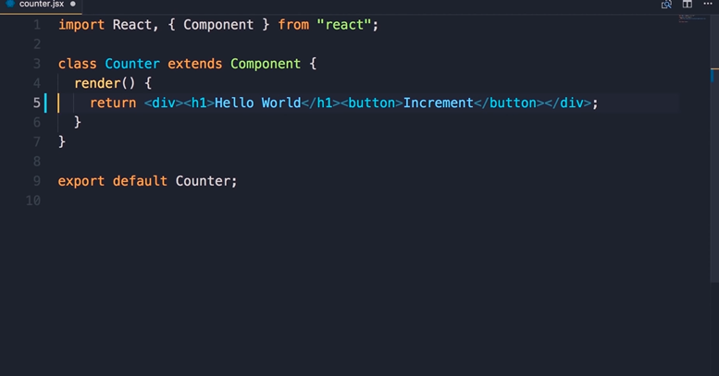

Slide 7
so one solution is to wrap this with a div
so div here and close it at the end now when babel sees this it will compile this expression down to something like this so we'll have a react element with the type div and inside of that element we'll have two other elements an h1 and a button

Slide 8
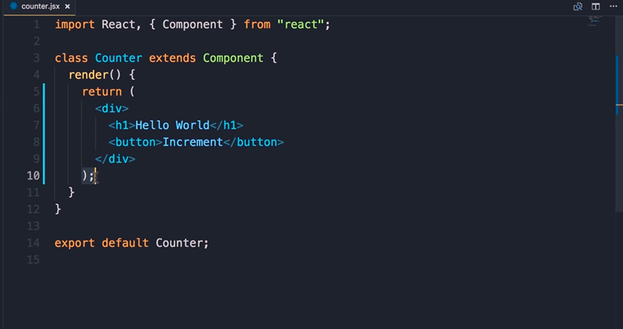

Slide 9
see what happens when you save the changes
the prettier extension that we installed , automatically reformatted this expression now it's more readable and it also put parentheses around that this is essential because of something that we call automatic semicolon insertion .

Slide 10
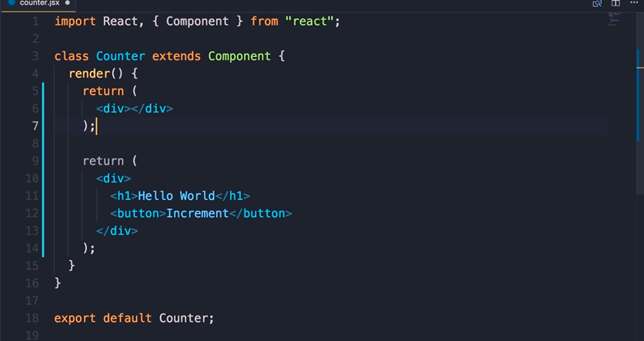

Slide 11
so in JavaScript if you have a return statement and nothing in front of it JavaScript will automatically put a semicolon here so if you add a div on the next line javascript is not gonna see that it thinks you have a return statement with nothing in front of it
to solve this problem we should put a parenthesis right in front of the return keyword and then close it at the end of our JSX expression.
so delete now

Slide 12
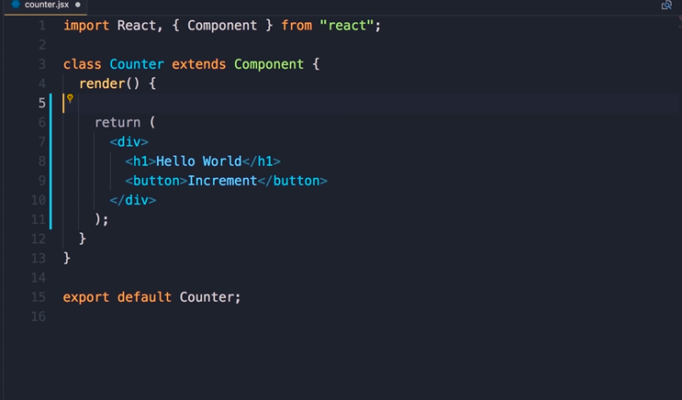

Slide 13
the thing is that whenever you're dealing with a long JSX expression as soon as you save the file this prettier extension would automatically put these parentheses for you so you don't have to do it manually

Slide 14
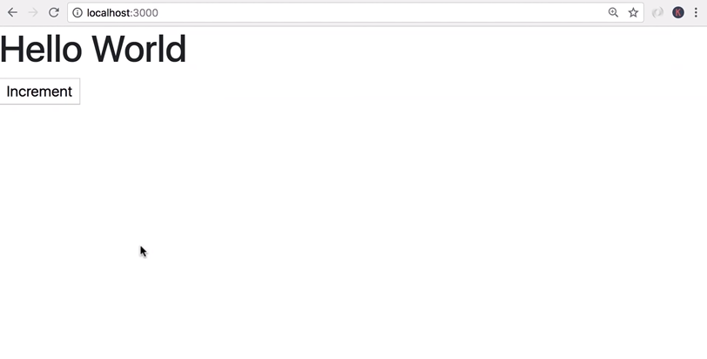

Slide 15
all right save the changes now back in the browser here's our button

Slide 16
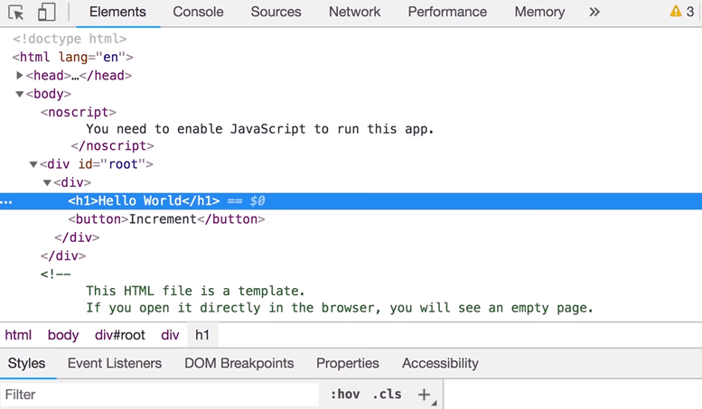

Slide 17
let's inspect this so here
we have this div with the ID root this is coming from our index.HTML
Which we saw at in the previous session
this is the div or the container for our react application inside of this div we have this other div which we added a minute ago to wrap our h1 and button elements

Slide 18
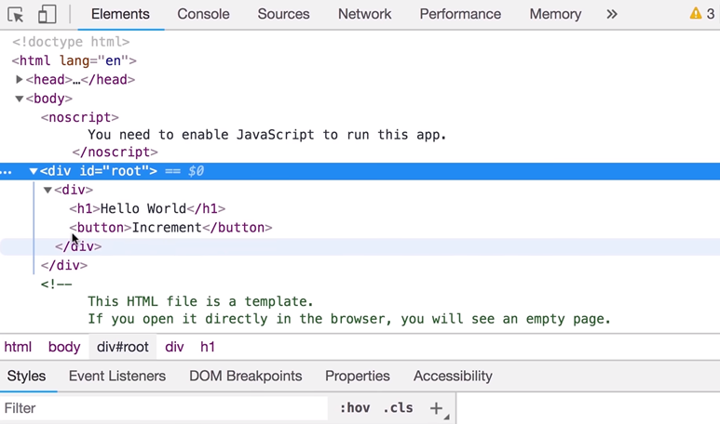

Slide 20
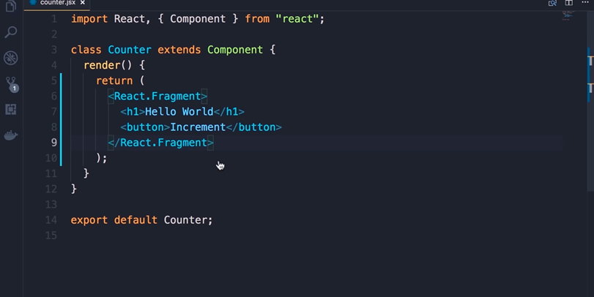

Slide 21
sometimes you don't want an extra div that is not doing anything here in that case you can use react.fragment
back in the code we imported this react object on the top
this react has a child called fragment so we can replace these two divs with react.fragment
now if you're curious how I edited both these instances at the same time this is called multi cursor editing so we can select a piece of code press command + D on mac or control-d on windows to find another occurrence of that selection now if you have more occurrences you keep pressing command + D or ctrl d
now we have multiple cursors we can change all instances in one go so react fragment

Slide 22
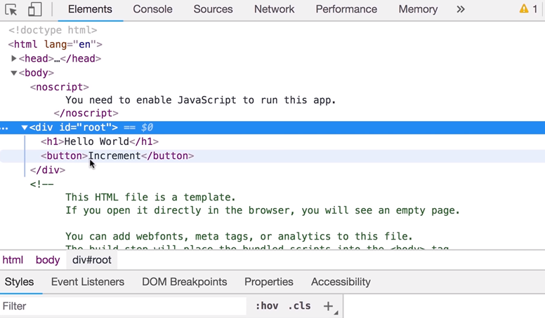

Slide 23
now save the changes back in the browser this time inside of our root div we only have the h1 and the button they are not contained by another div alright

